Slide 1

Group #5:
Rahul Shome
Valia Kalokyri
Careena Braganza
Nirali Shah
Nivetha Balasamy
Thara Philipson

Slide 2
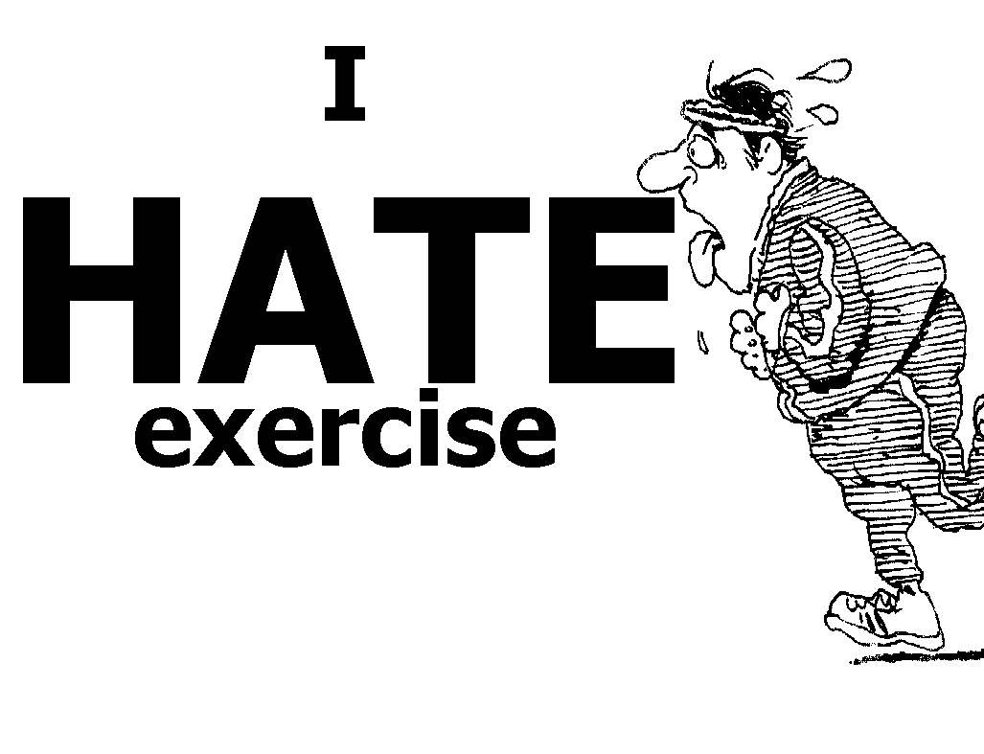
Motivation
Sticking to exercise regime is difficult due to lack of time and low motivational levels.
Music makes exercise interesting,
Research shows that correct music can enhance the exercising experience, limit the feeling of compulsion and make the exercise productive.
Songs not matching the taste of the user may spoil his mood and demotivate him from continuing.
Exercise, when modified as a game to challenge friends and declare winners, can create additional drive.
Analysing a workout is the most effective way of providing encouraging information.

Slide 3

Contribution
Detects user’s steps
Plays songs with equivalent bpm from user’s youtube playlist.
Provides Training templates for exercise.
Provides Challenge mode to compete with friends.
Provide weather forecast for best time and place.
View Graphical representation to monitor exercise routines.

Slide 4
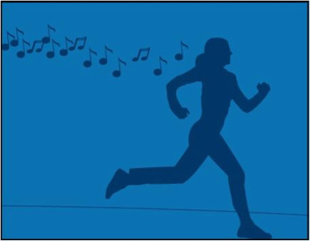
Implementation
Sign in with Google account
Gets access to the user’s youtube playlist details.
The User begins his run.
Sense user’s steps per minute
Calculate Beats per Minute (Bpm) of the songs via Echonest API
Song with matching bpm is chosen from the user’s Youtube account.
User can switch between songs.
Challenge a friend

Slide 5

Continued...
User can challenge other app users to a Run
The selected opponent/s are notified when user sends a challenge. The opponent can choose to accept/decline the challenge.
Tournament mode, where one winner is declared from multiple challenges with leader board.
Training templates for different levels of exercise.
Graphical representation of data to track exercise details.
Visualization of previous accomplishments over past week and month

Slide 6
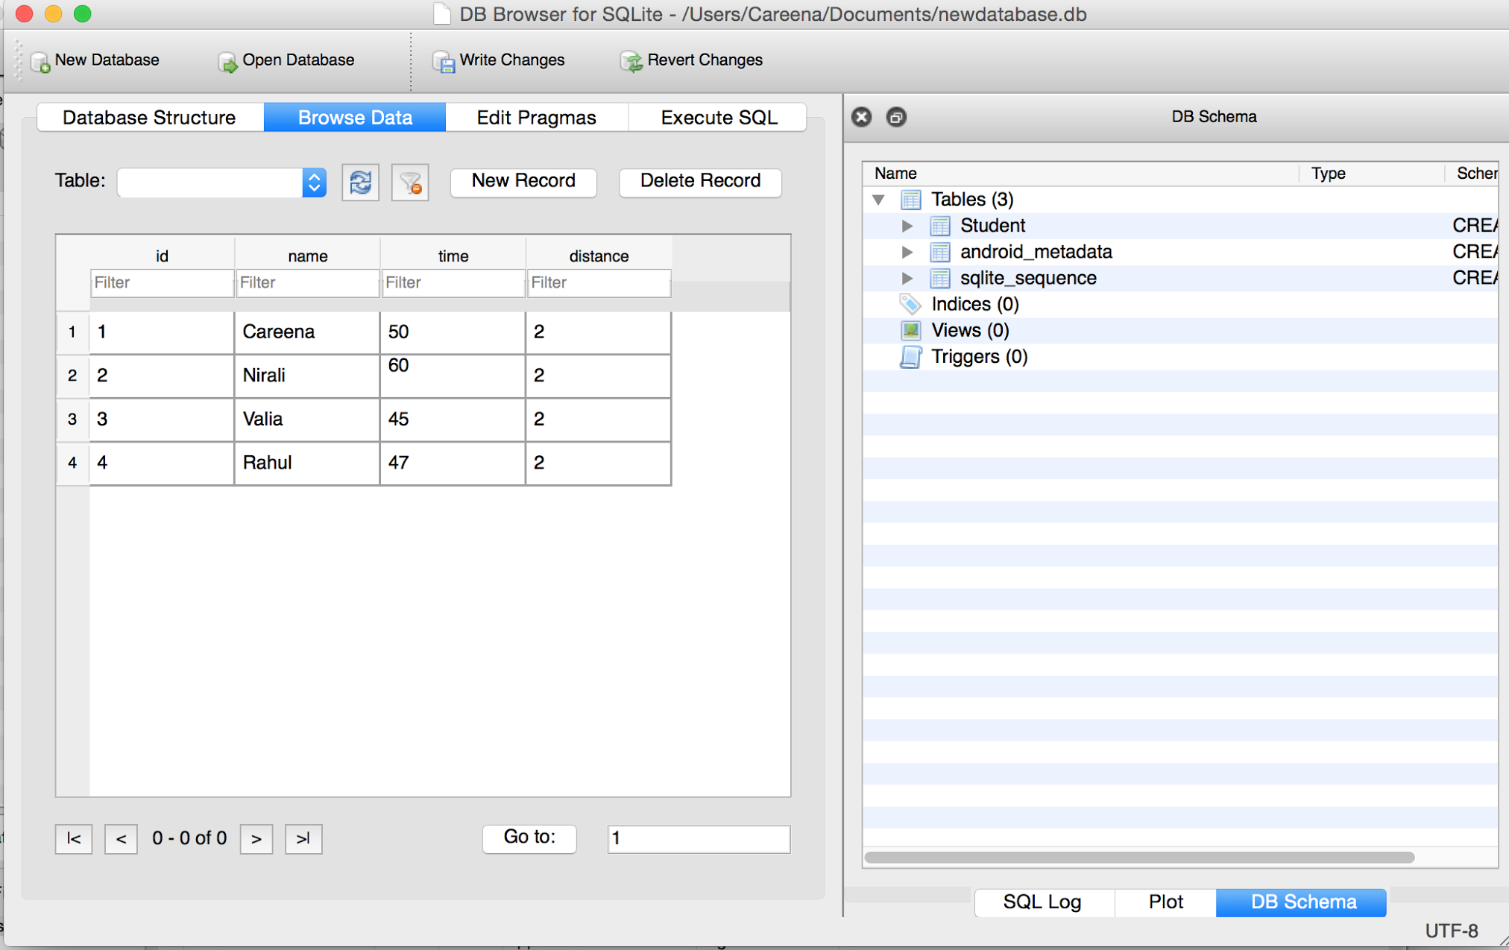
Database

